Slide 1
Mixed-skills Teaching Activities in Primary and Secondary Schools
寇优
youkou@rosendale.cc

Slide 2
A good teacher isn't someone who gives the answers out to their kids but is understanding of needs and challenges and gives tools to help other people succeed.
--Justin Trudeau

Slide 3
How to plan your lesson?
New Lesson: Vocabulary, phrases, sentences, paragraphs, culture
Revision lesson: What skills do your students need to practise?

Slide 4
Teaching Process
5-7 mins teaching
2-3 activities to practise
Revise and practise again (with/without new knowledge)

Slide 5
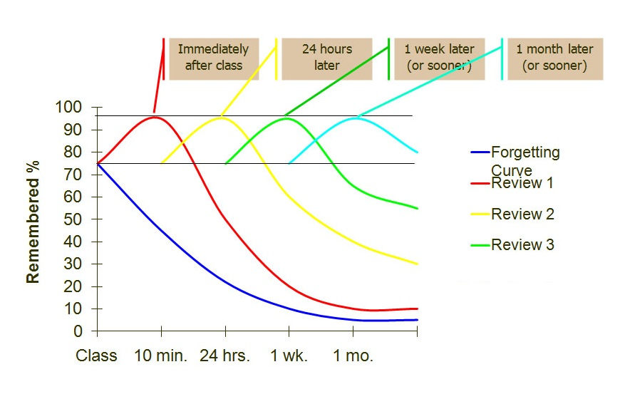
https://blog.synap.ac/10-surprising-facts-about-your-memory/#.XG8E-KL7TIU

Slide 6
Assessment
End of lesson check
Peer assessment
Test/Quiz
Exam

Slide 7
Teaching Methods
Learning skills decide the teaching activities
Instructions
Demonstration
Observe the activity
Outcome/Feedback

Slide 8
Teaching activities

Slide 9
Work with your partner

Slide 10
Find a partner

Slide 11
Work with your team
What skills can you practise with these activities?
What topic/content can you use with these activities?
When can you use them?
https://www.youtube.com/watch?v=Y-AYC3_DbpY
http://www.intervaltimer.com/timers/8274201-work-with-your-team-timer

Slide 13
Work with your team
Please continue to write a paragraph on the sheet.
星期日的早晨，我睁开眼睛看到……

Slide 14
Please pick up one activity on your table and think about:
What skill(s) does this activity do?
What topic can you use with this activity?
When and How can you use this activity?
How to make this activity a better version?
Please give an instruction of this activity.

Slide 16
Behaviour

Slide 17
What you do speaks so loud that I can’t hear what you say.
--Ralph Waldo Emerson

Slide 18
What bahaviour problems did you have?
Why do the students misbehave?
How to deal with the misbehaviour?

Slide 19
7 positions: Attention Seeking, Avoiding Failure, Angry, Control Seeking, Energetic, Bored, Uninformed
Source: Win Win Descipline, S Kagan, P Kyle, S Scott, Kagan Publishing, 2004

Slide 22
Work with your team
Please write down what your school does well and what help you need from your school on the post-it.

Slide 23
Class tools
https://www.classtools.net/
Name selector: http://www.abcya.com/random_name_picker.htm
Number selector, Colour selector, Timer
https://www.online-stopwatch.com/countdown-timer/
https://www.google.co.uk/search?safe=strict&ei=8fVvXM6tAZqr1fAPnreMkAU&q=timer&oq=timer&gs_l=psy-ab.3..35i39j0i67l6j0l3.938850.939656..939995...0.0..0.179.699.1j4....2..0....1..gws-wiz.......0i71j0i131.4tCvkHBK3Do

Slide 24
Mixed-skills Teaching Activities in Primary and Secondary Schools
寇优
youkou@rosendale.cc

